Slide 1
Visualizing COVID-19 Spread Rate
IST 687 – Final Project
Jeffrey Chao – jchao01@syr.edu
Christopher Bailey – cbaile01@syr.edu
Mario Ruiz – mjruiz@syr.edu

Slide 2
Project Overview
Considering the current situation surrounding COVID-19, the team took a strong interest in understanding “How bad can bad be?”
Through this lens, the team put a focus on anticipating the global spread rate.
A dataset was made available from the John Hopkins Center for Systems Science and Engineering. JH CSSE Dataset
The “data science” began…

Slide 3
Project Overview Continued
The team held several working sessions to discuss:
Strategy about how best to understand what a “spread rate” looks like
Much discussion on all available data sources
Which are the most appropriate visualizations
What are some appropriate modeling techniques
Division of efforts
How to keep organized
Mario – PM /Docs/SwE/Contrarian
Jeff – DS/SwE/Master Data Cleanser
Chris – DS/SwE/Best Hair

Slide 4
Spread Rates

Slide 5
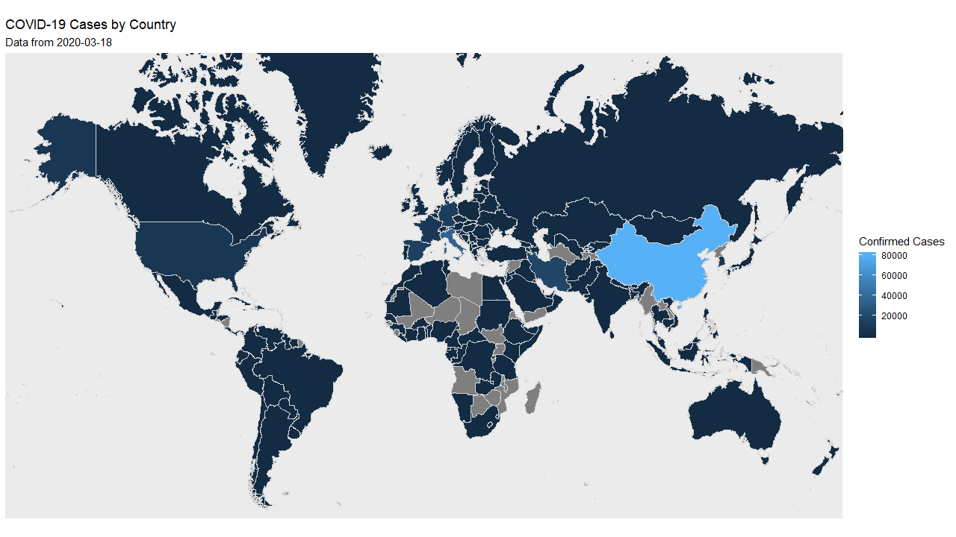
Spread Rates

Slide 6
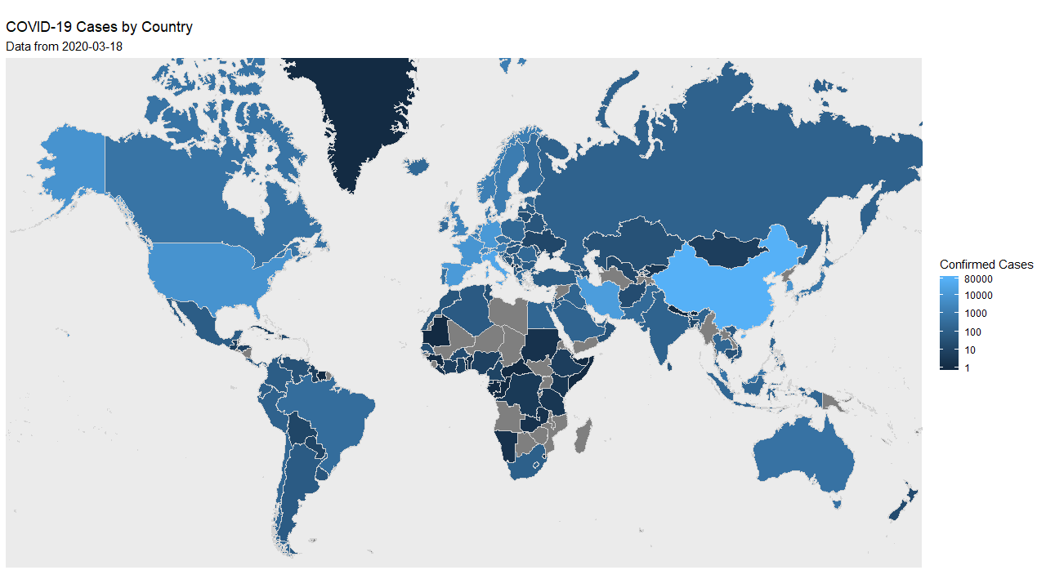
Spread Rates

Slide 7
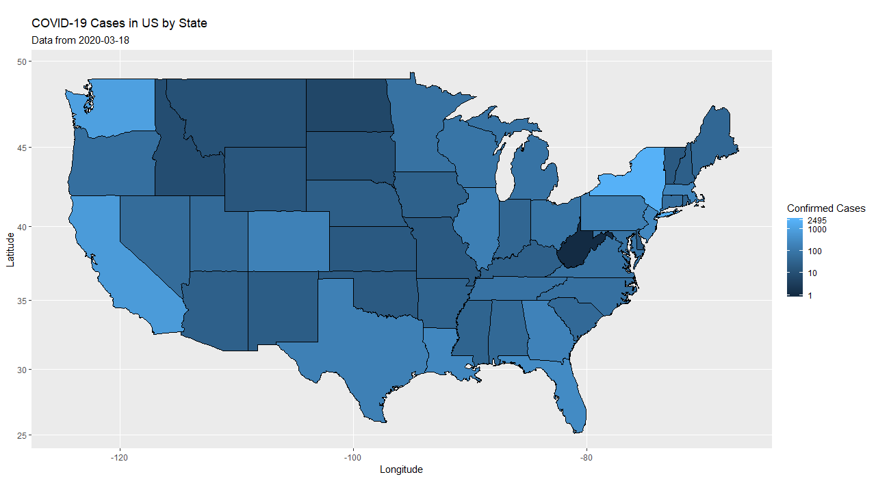

Slide 8
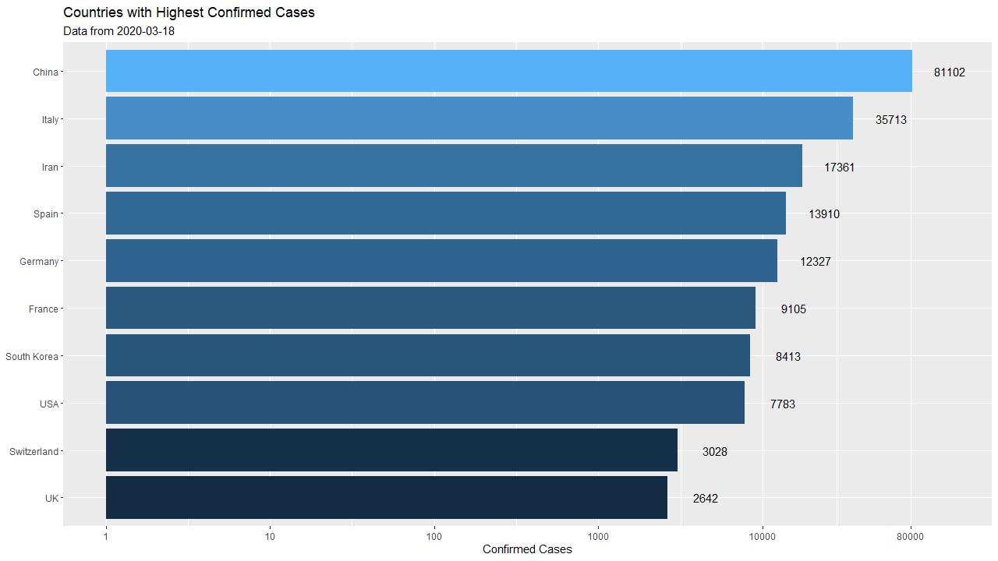

Slide 12
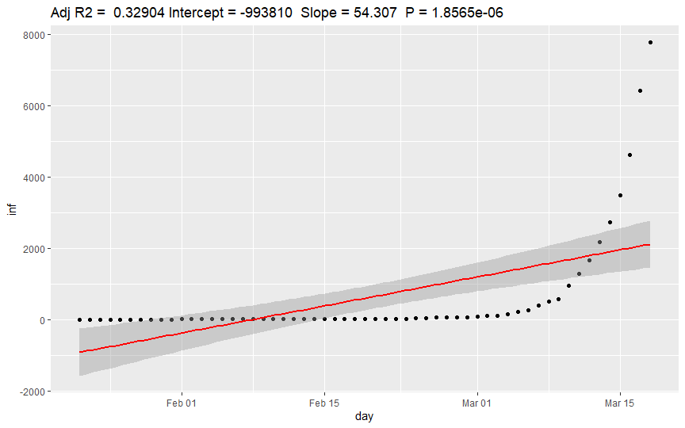

Slide 13
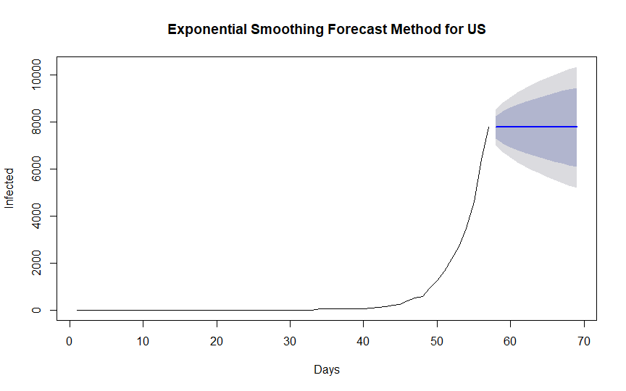

Slide 14
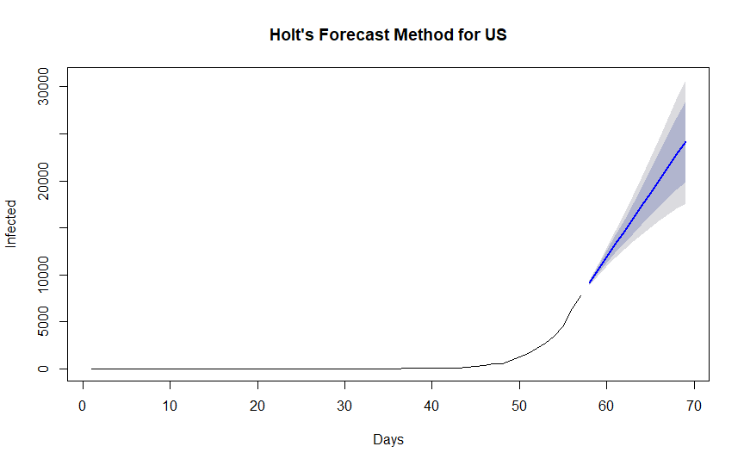

Slide 15
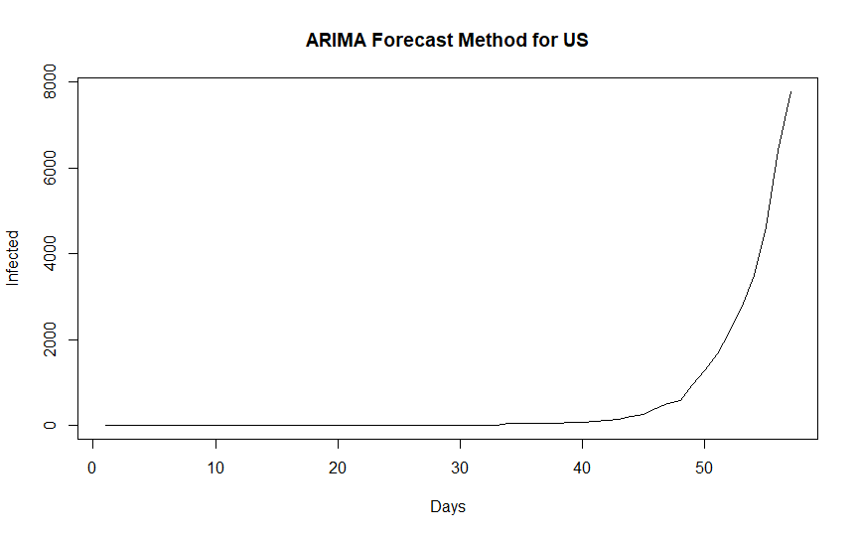

Slide 16
Summary of Meeting Notes

Slide 17
First Meeting Notes
Strategy discussion regarding focus and goal of project
Where to find the best data set
What visualizations to focus in on
Discussion around simulation/modeling
Time Series?
Kalman Filtering technique
Division of effort – PM/SWE = MR / DS=JC / DS/SWE = CB
Established Dedicated Slack / Github - MR
Cleaned Dataset – JC/CB

Slide 18
Second Meeting Notes
Focus on dataset cleaning – JC/CB
Which visuals? – All
Code documentation – MR
Revisit timeseries approaches
Is our data appropriate? This is an evolving current event
Refined global visualization based on log scale
Coding experience – variable naming/testing code

Slide 19
Third Meeting Notes
Jeff cleaned up the code to be more readable and modular – source()
The current visualization are predicated on per-day
Do we modify this to consider a larger time dimension?
3D visual?
Chris – Visual of china vs nochina highlighted a significant delta between the different countries
Open question – being able to provide a general “spread rate” – How?

Slide 20
4th Meeting Notes
Chris – Animation complete
For total some functions inserted a NA → isNA function remove?

Slide 21
Lessons Learned

Slide 22
Project Recap
Much time was spent on data cleaning; ~65-70%
Who cares about “warnings” ;-)
Open Question -

Slide 23
Thank you!

